Slide 1

Predicting Medical Insurance Premium
By,
Vivek Hosahalli Narayanareddy

Slide 2
Table of Contents
01
03
02
04
.1
.1
Introduction
ML Models
Health Insurance Coverage in the United States: 2019
Summarize the models and their accuracy
.1
.1
Project Goal
Future Steps
To Help People Compare and Choose the Right Health Plan
Long term implication of ML Model

Slide 3
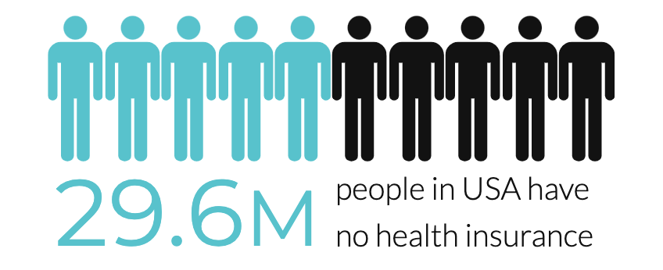
Health Insurance Coverage in the United States: 2019
In 2019, 9.2 percent of people, or 29.6 million, were not covered by health insurance
Without health insurance the average doctor appointment costs between $300-$600
New study finds 45,000 deaths annually linked to lack of health coverage

Slide 4

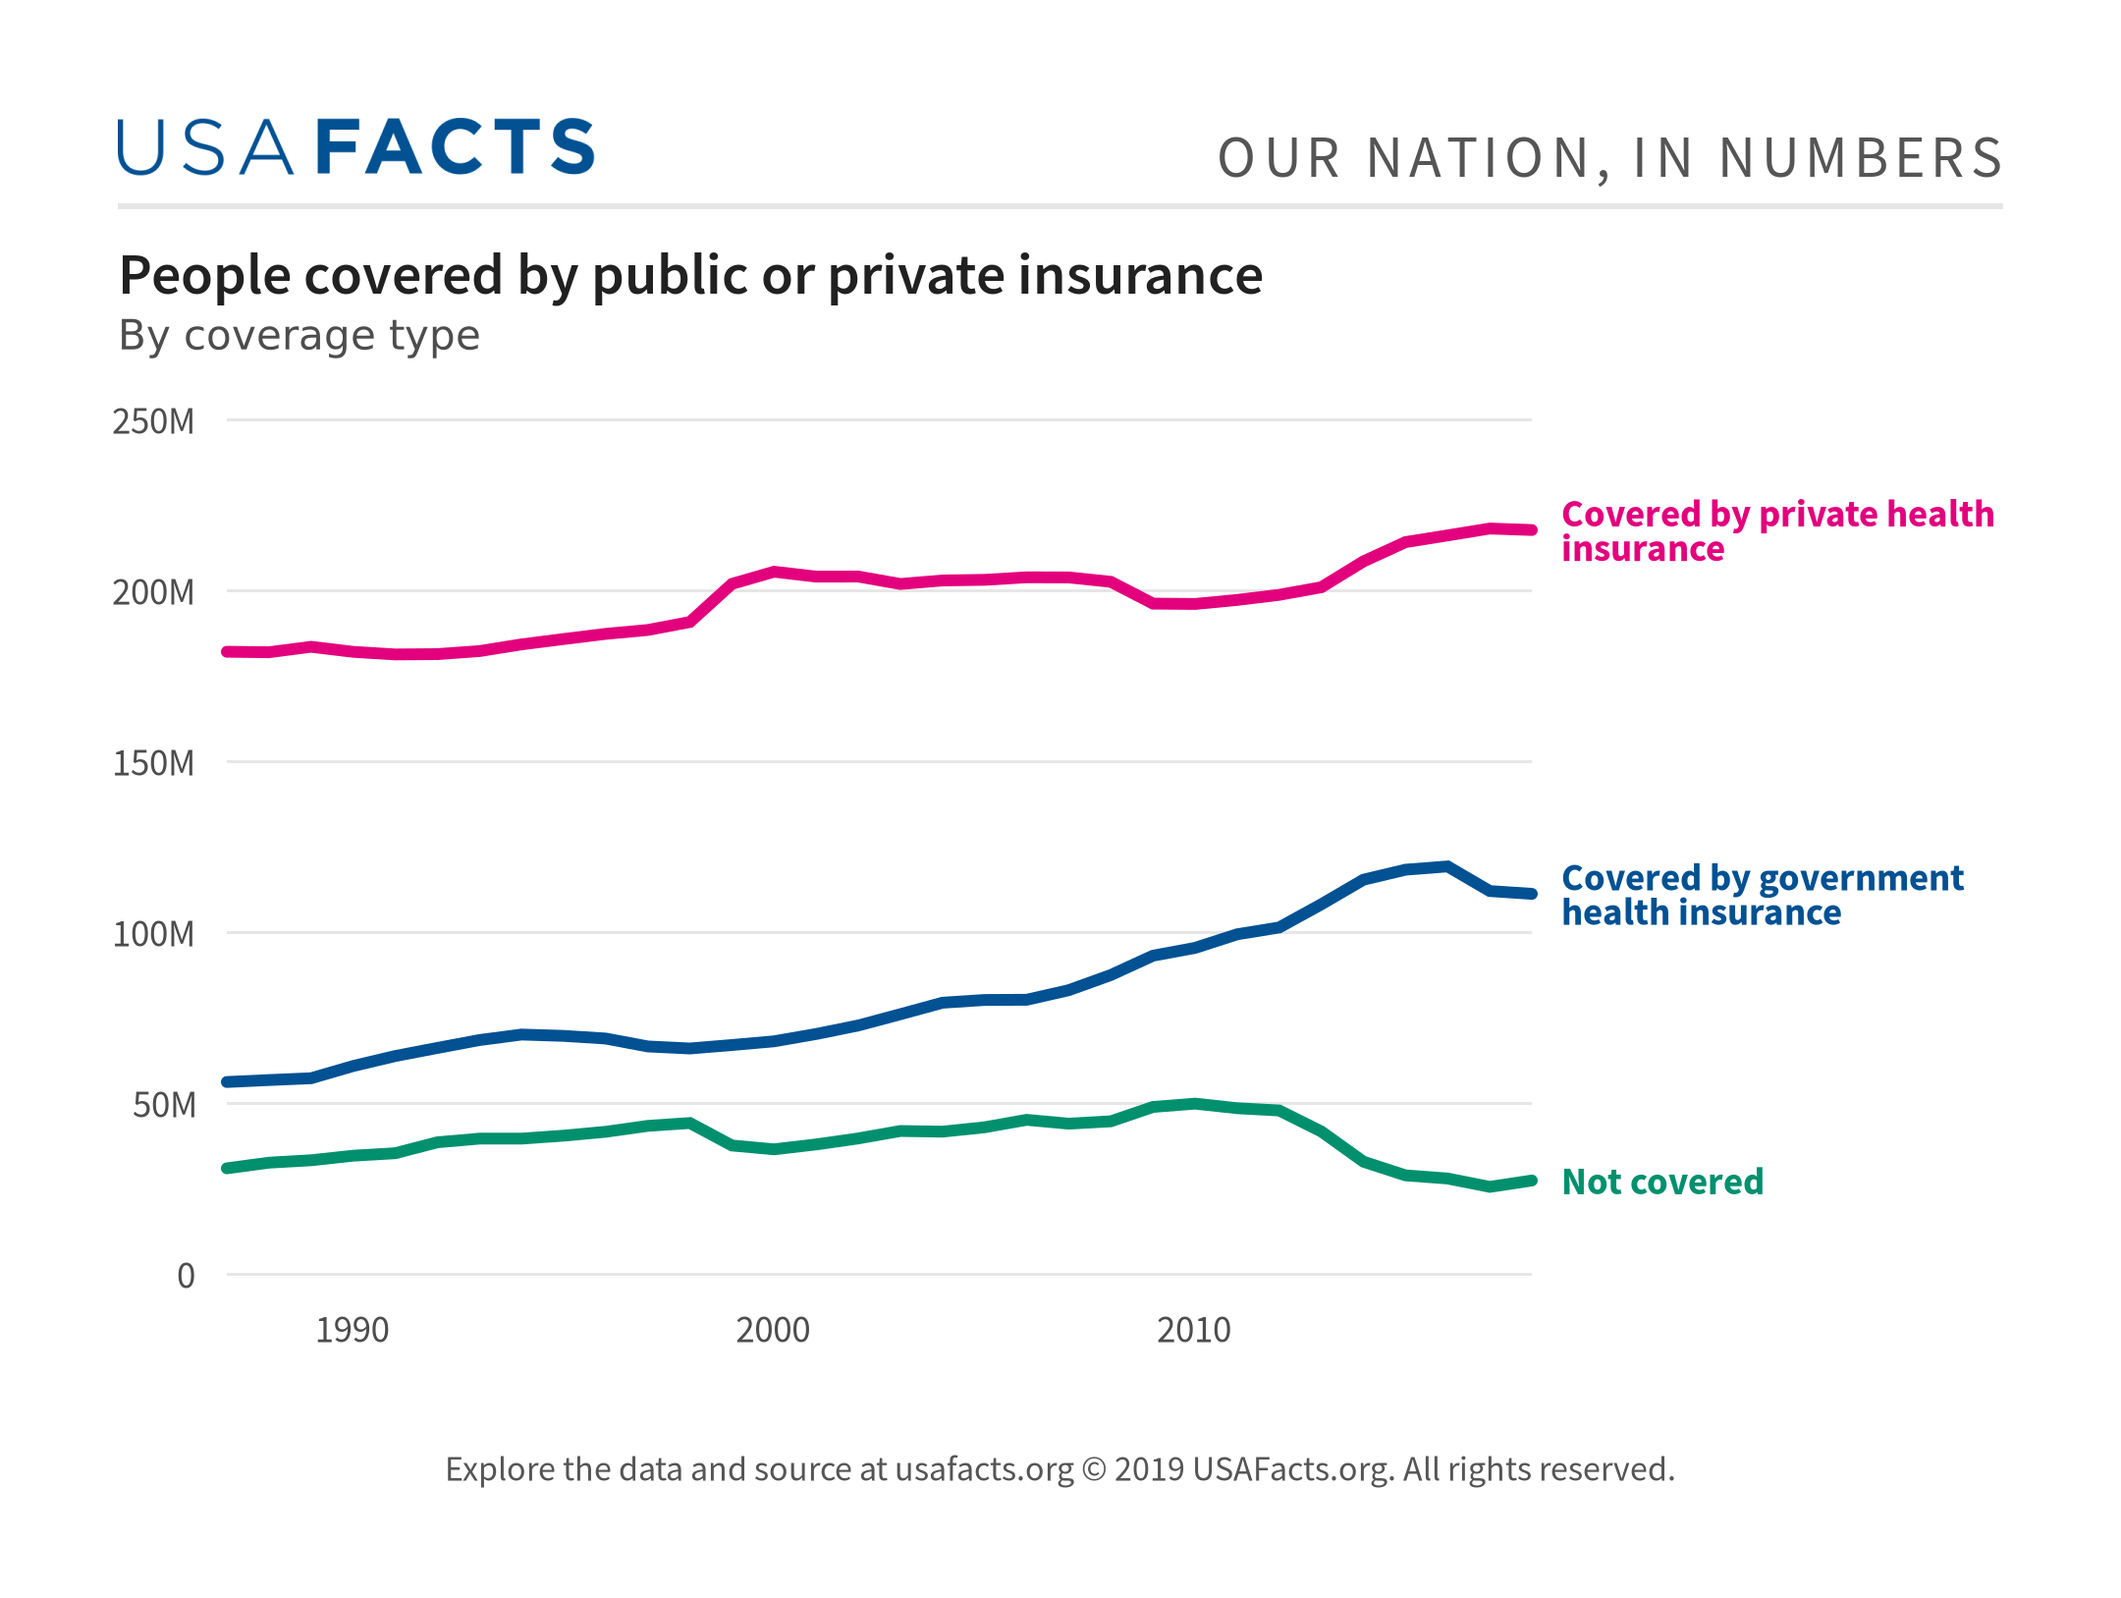
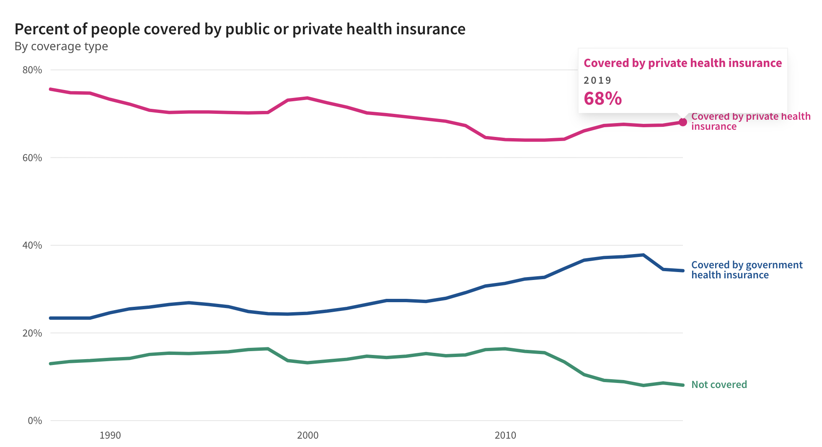
How do most Americans get their health insurance?
More than two-thirds of Americans get their health insurance from private insurers. More than half of all insurance coverage is employer-provided.

Slide 5
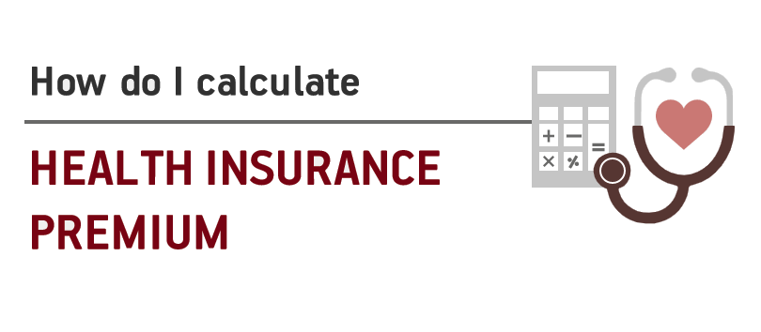
Goal: To Help People Compare and Choose the Right Health Plan
The healthcare premiums keep changing every year because of various factors such as medical trends, pharmaceutical trends, and political factors etc. over which the customer has no control
Educate people on Health plans, For example, just by eliminating smoking and lowering the BMI by a few points might mean saving thousands of dollars from premium charges

Slide 6

Understanding the data
Column Description :
Age: Age of primary beneficiary
Sex: Primary beneficiary’s gender
BMI: Body mass index (providing an understanding of the body, weights that are relatively high or low relative to height)
Children: Number of children covered by health insurance / Number of dependents
Smoker: Smoking (yes, no)
Region: Beneficiary’s residential area in the US (northeast, southeast, southwest, northwest)
Charges: Individual medical costs billed by health insurance

Slide 7

Explanatory Data Analysis

Slide 8
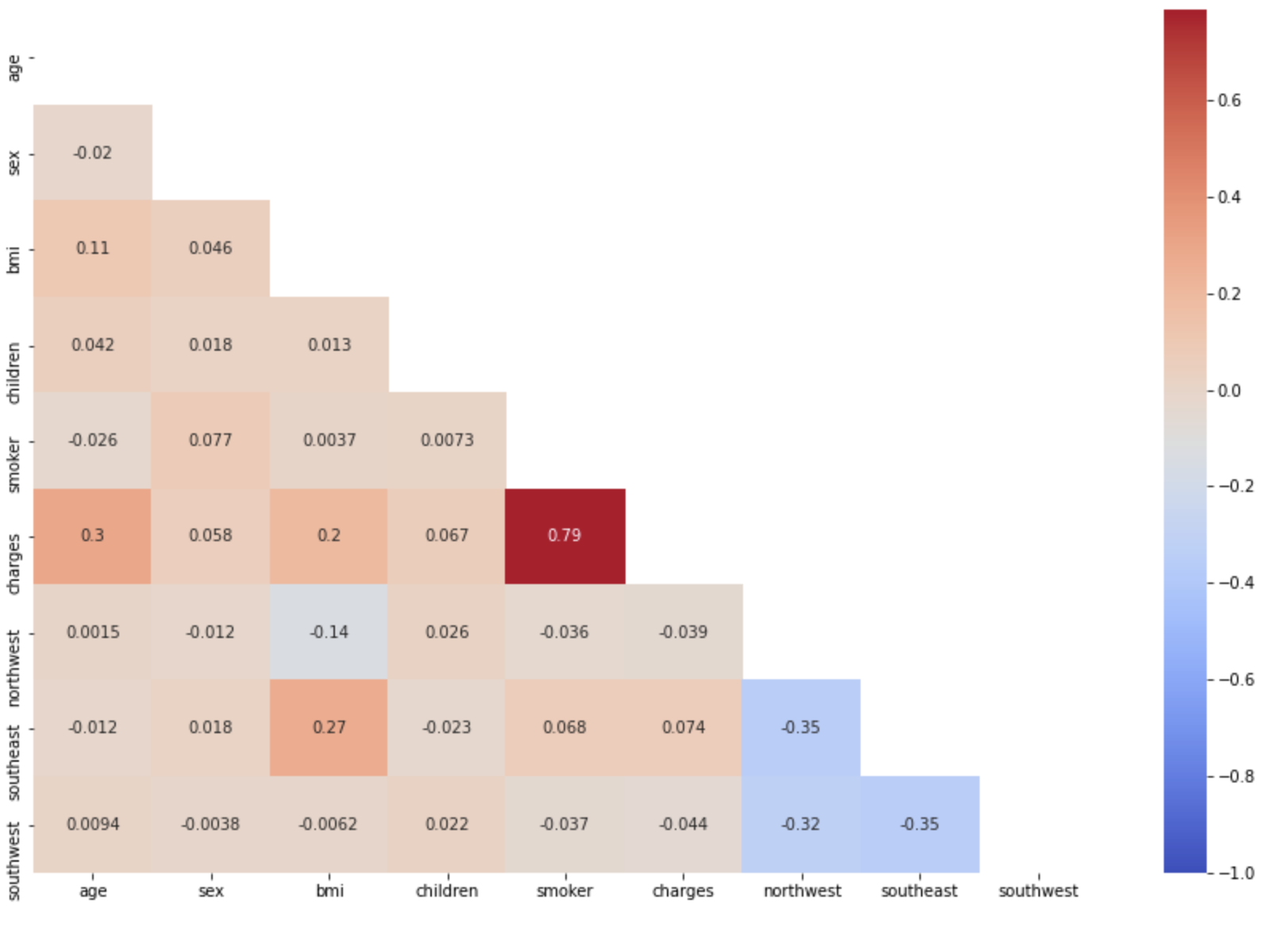
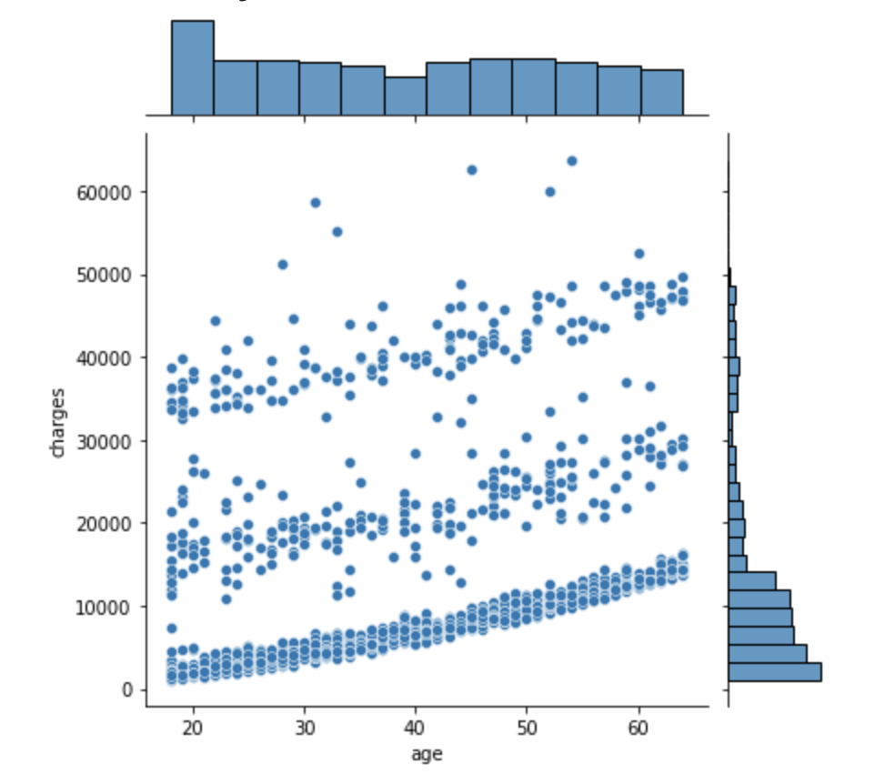
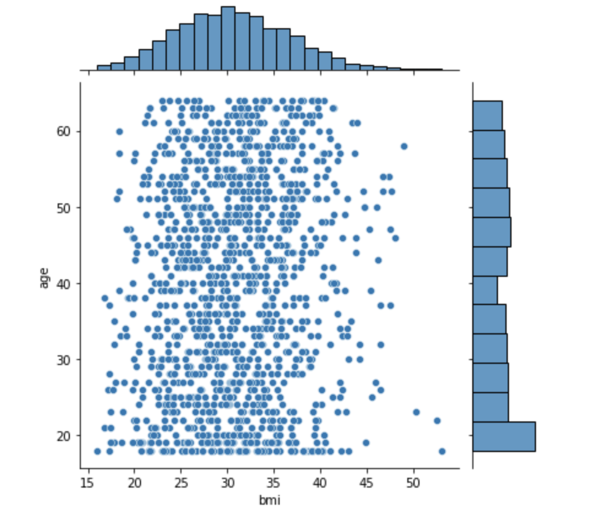
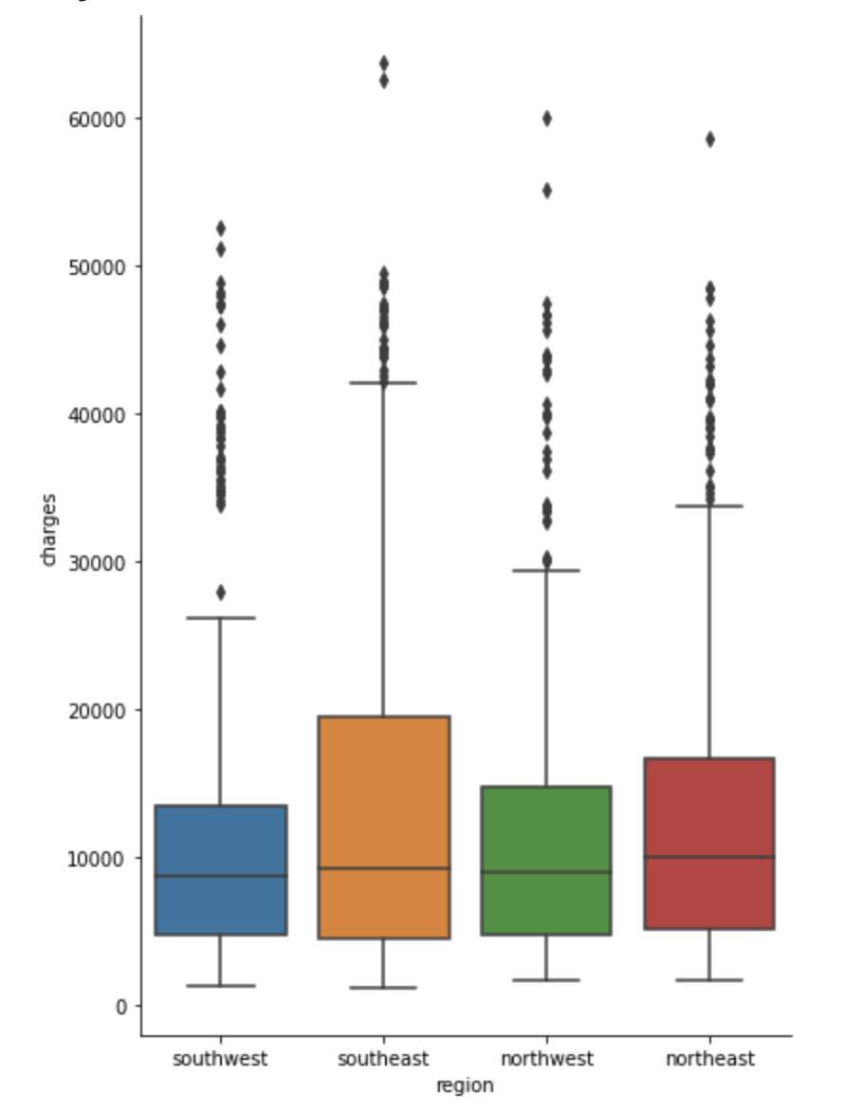
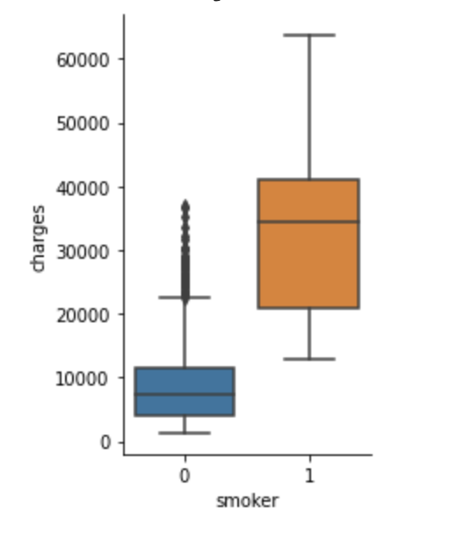
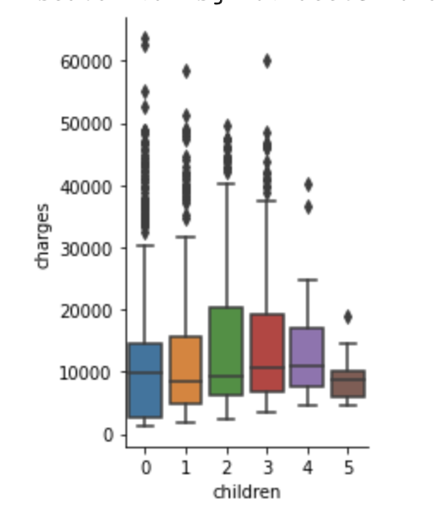
Plots
Correlation Plot
Age Vs Charges
Age Vs BMI
Region Vs Charges
Smoker Vs Charges
No of Children Vs Charges

Slide 9
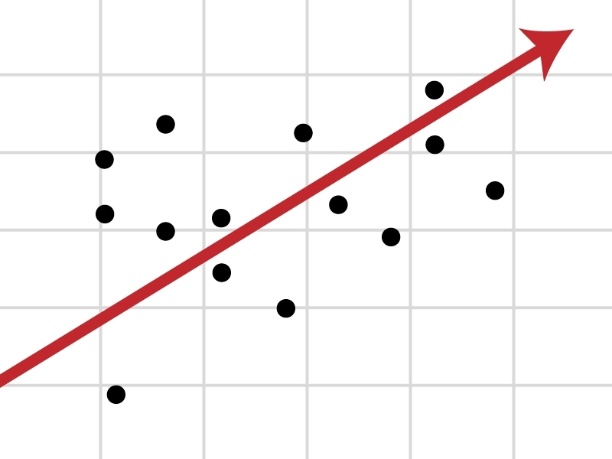
Linear Regression Model

Slide 10
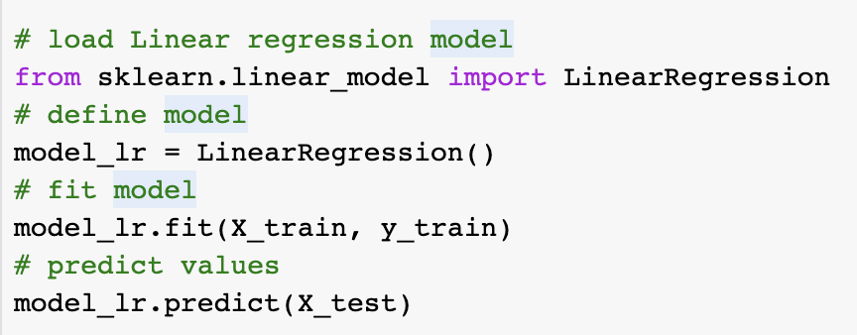
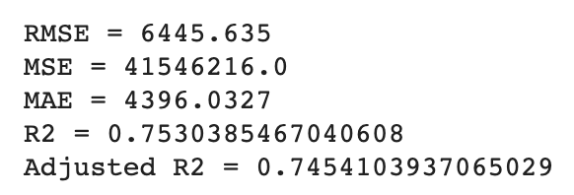
Linear Regression Model
Linear regression is a supervised learning algorithm and mainly used for Regression.
Linear Regression establishes a relationship between dependent variable (Y) and one or more independent variables (X) using a best fit straight line.
Code
Performance Metrics

Slide 11
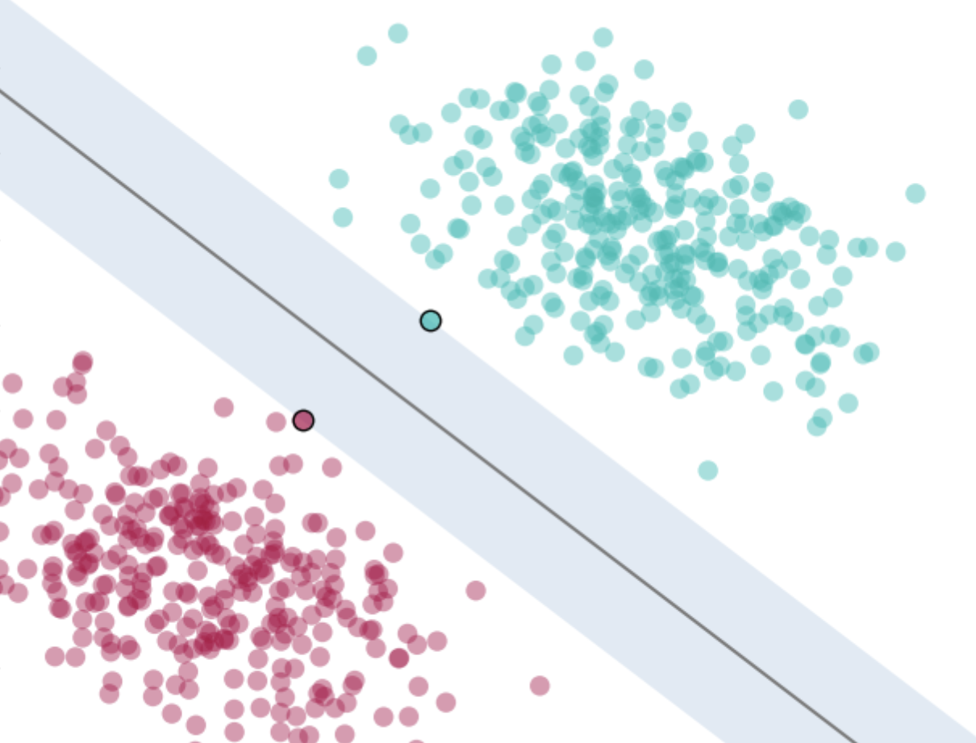
Support Vector Regression Model

Slide 12
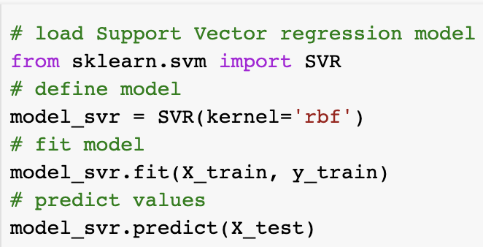
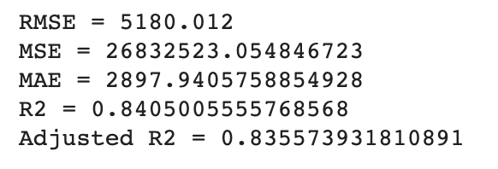
Support Vector Regression Model
Support Vector Regression (SVR) uses the same principle as SVM, but for regression problems.
SVM algorithm, plots each data item as a point in n-dimensional space (where n is number of features you have) with the value of each feature being the value of a particular coordinate.
Code
Performance Metrics

Slide 13
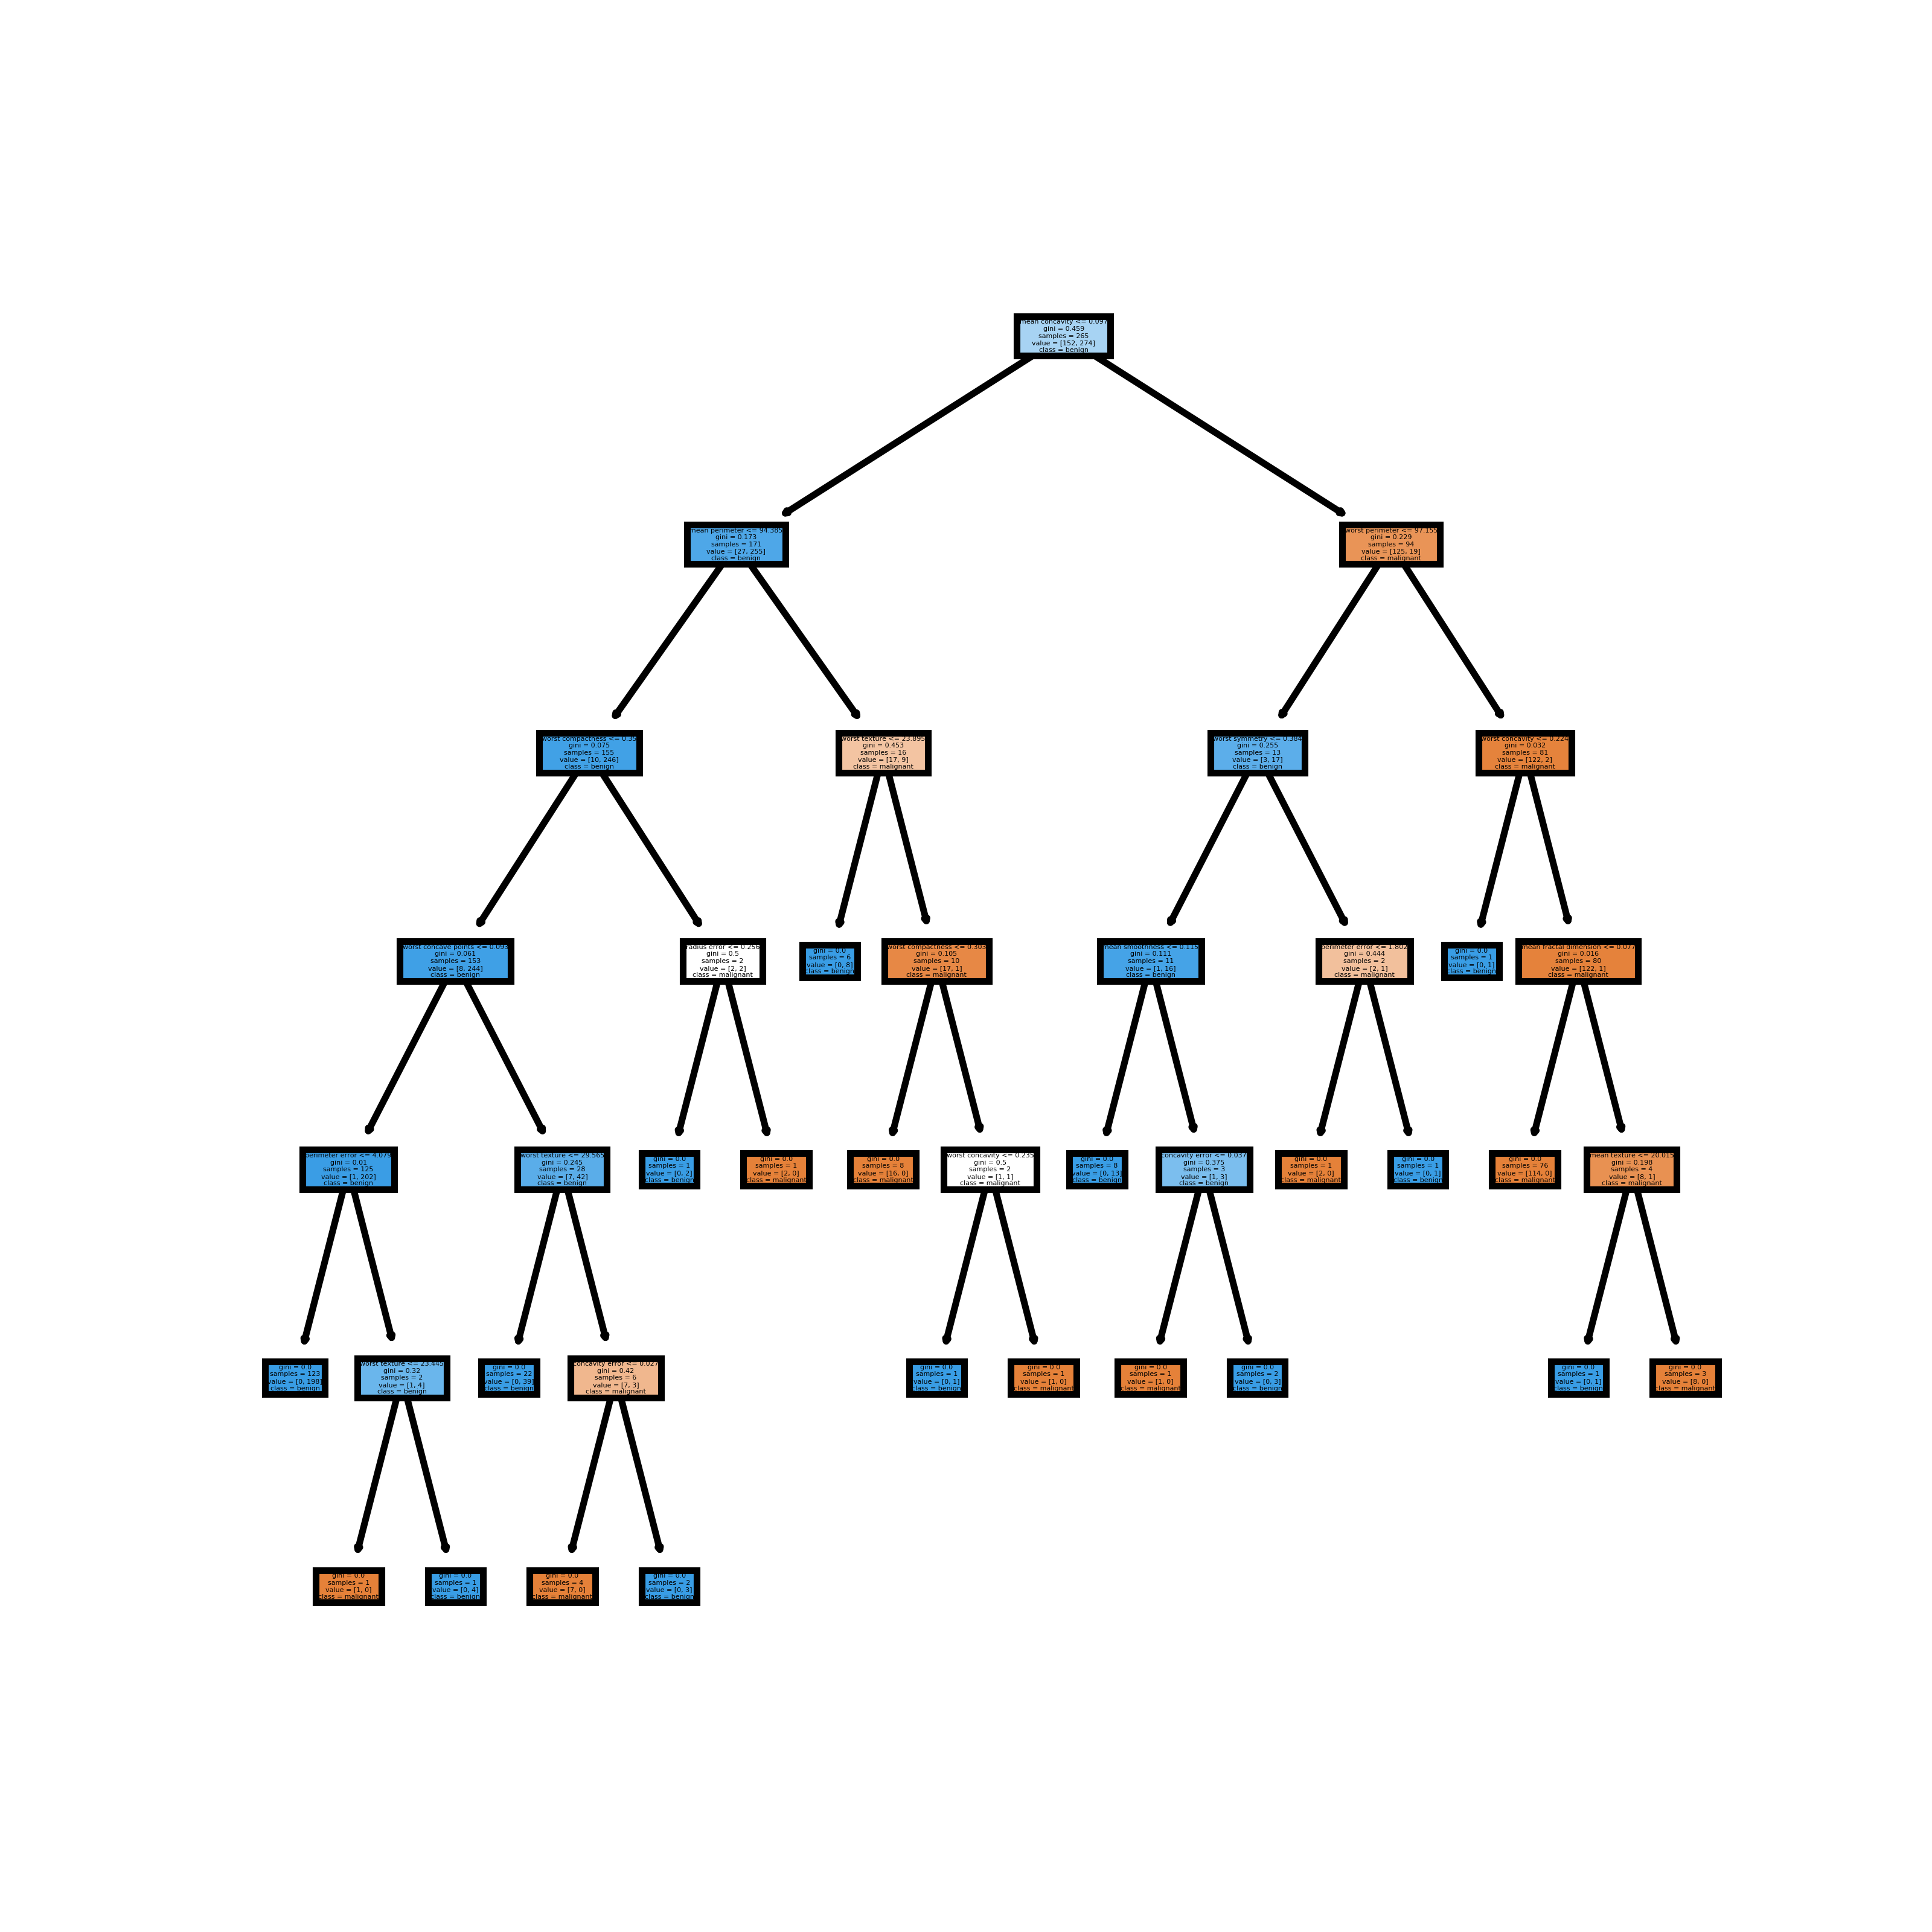
XGBoost Model

Slide 14
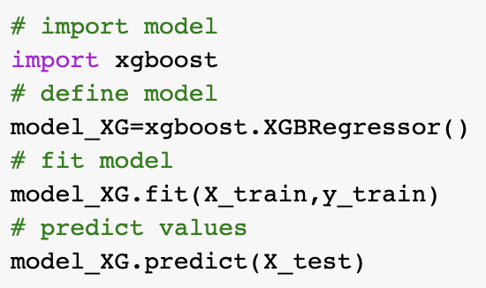
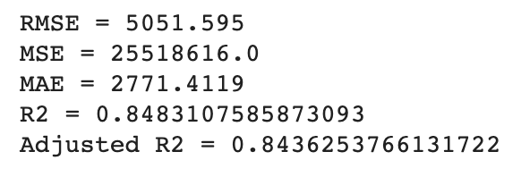
XGBoost Model
XGBoost stands for eXtreme Gradient Boosting. Boosting is an ensemble technique where new models are added to correct the errors made by existing models. Models are added sequentially until no further improvements can be made.
Code
Performance Metrics

Slide 15
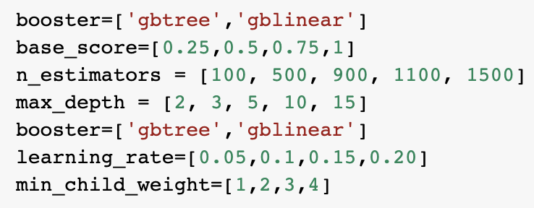
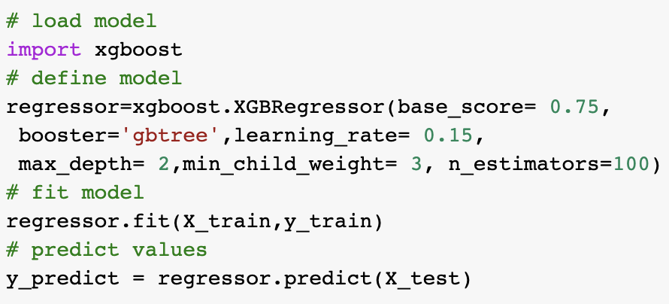
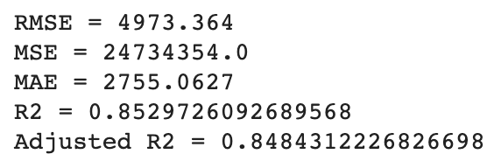
Tuning XGBoost Model using Random Search
Random search is a technique where random combinations of the hyperparameters are used to find the best solution for the built model. It is similar to grid search, and yet it has proven to yield better results comparatively.
Parameter grid :
Code
Performance Metrics

Slide 16

Future Steps

Slide 17
Next Steps
3 Months
Improve Model Performance using Cross Validation
Use Regularization Techniques like (lasso and ridge)
Extract more information from existing data (feature and transformation extraction)
1 Year
Stacking Models for Improved Predictions – Stacking is an ensemble learning technique that uses predictions from multiple models (for example decision tree, KNN or SVM) to build new model
Hyperparameter Optimization with Random Search and Grid Search
Deploy the model on cloud for Prediction – https://health-insurance-premium-predi.herokuapp.com/

Slide 18
References
How do most Americans get their health insurance? - USAFacts. (2020). Retrieved 20 October 2020, from https://usafacts.org/articles/how-most-americans-get-their-health-insurance-medicare-employers/
Ray, S. (2020). How To Increase Accuracy Of Machine Learning Model. Retrieved 20 October 2020, from https://www.analyticsvidhya.com/blog/2015/12/improve-machine-learning-results/

Slide 19
Thank You!
Any Questions?

